Slide 1


Advanced Topics in Globus: Automation with the Globus Timer, Globus CLI, and Globus SDK
Brian Roland
Data Management Specialist
Northwestern IT
Research Computing and Data Services

Slide 2
Agenda
Challenges of Manual Data Management
Globus Automation Opportunities
Live Demo
  Globus Scheduler & Timer
  Globus CLI
  Globus CLI in Bash script
  Globus SDK
    App Registration
    Native App
    Service Account App

Slide 3
The Challenge of Manual Data Management
In today's research landscape, scientific workflows often involve the movement of large datasets between various storage locations. Manually managing these data transfers can present a variety of challenges:
Time-consuming file transfers
Error-prone processes
Difficulty in tracking transfers and task progress
Limitations when integrating data movement into complex workflows

Slide 4
Globus Automation to the rescue!
Globus offers automation options that can be leveraged to help address the challenges of data management. You can improve the efficiency of your research workflows by leveraging:
Timer functionality native to the browser interface for scheduling tasks
Globus Command Line Interface (CLI) for scriptable transfers
Globus Software Development Kit (SDK) for integrating Globus capabilities into your own applications.
Automating data transfers minimizes manual intervention, reduces errors, and ensures data movement happens seamlessly within your scientific pipelines, allowing you to focus on the core aspects of your research.

Slide 5
Automating Transfers with Globus Timers
Embedded within the web interface, Globus offers the timer feature for automating transfers
Ideal for datasets requiring frequent synchronization or scheduled backups
Flexible scheduling options including hourly, daily, weekly, monthly, or other custom time intervals

Slide 6
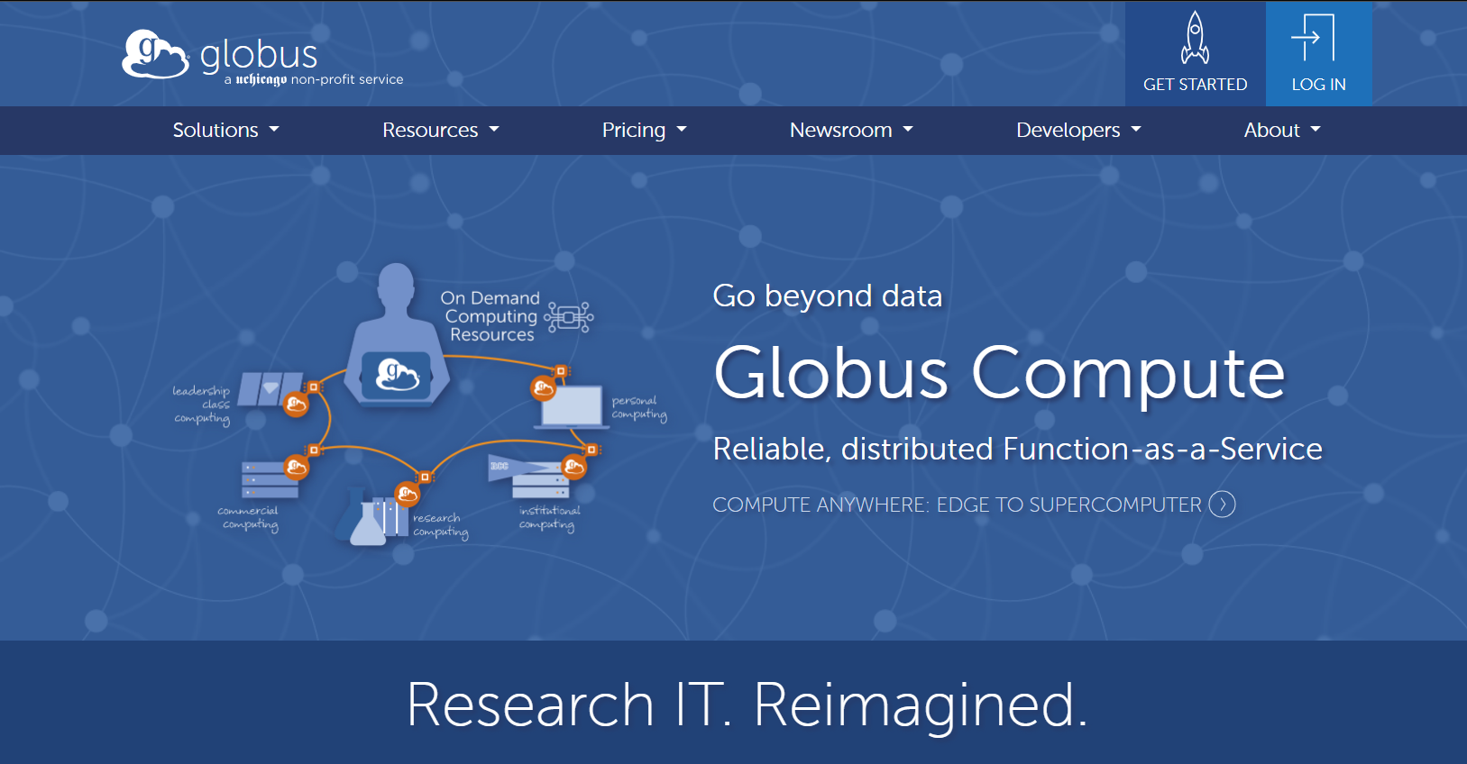
https://www.globus.org/

Slide 7
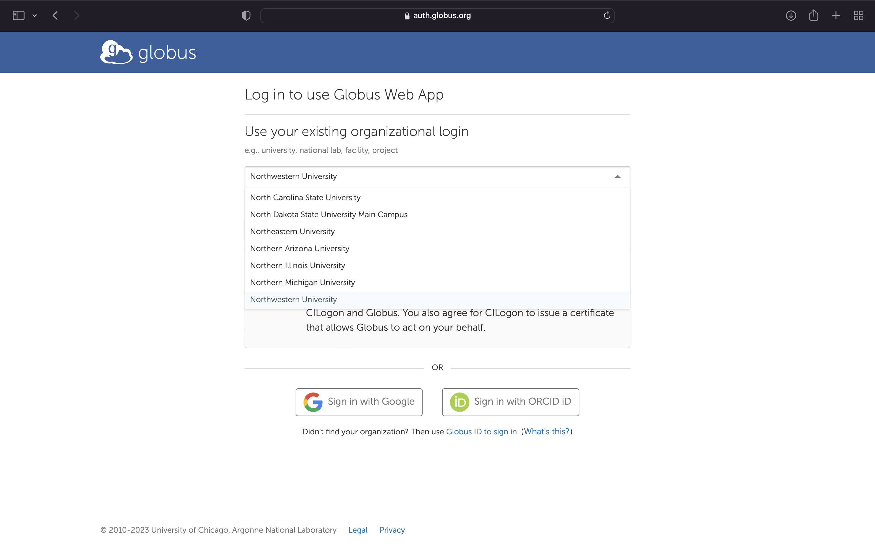
Logging in via NU Credentials

Slide 8
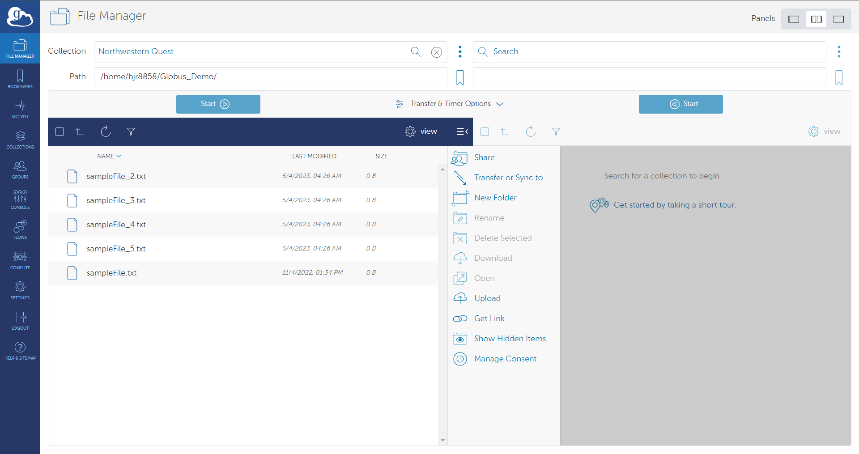
File Manager: Selecting Data Source
To select a Collection to serve as the data source, click in the Collection text field and type in the name or the UUID of the collection
Once the you select a Collection, you can navigate to the path they want to access manually or type it into the Path field.
Globus will display the files and subdirectories in the path provided. You can select which files and directories you want to transfer from the data source.

Slide 9
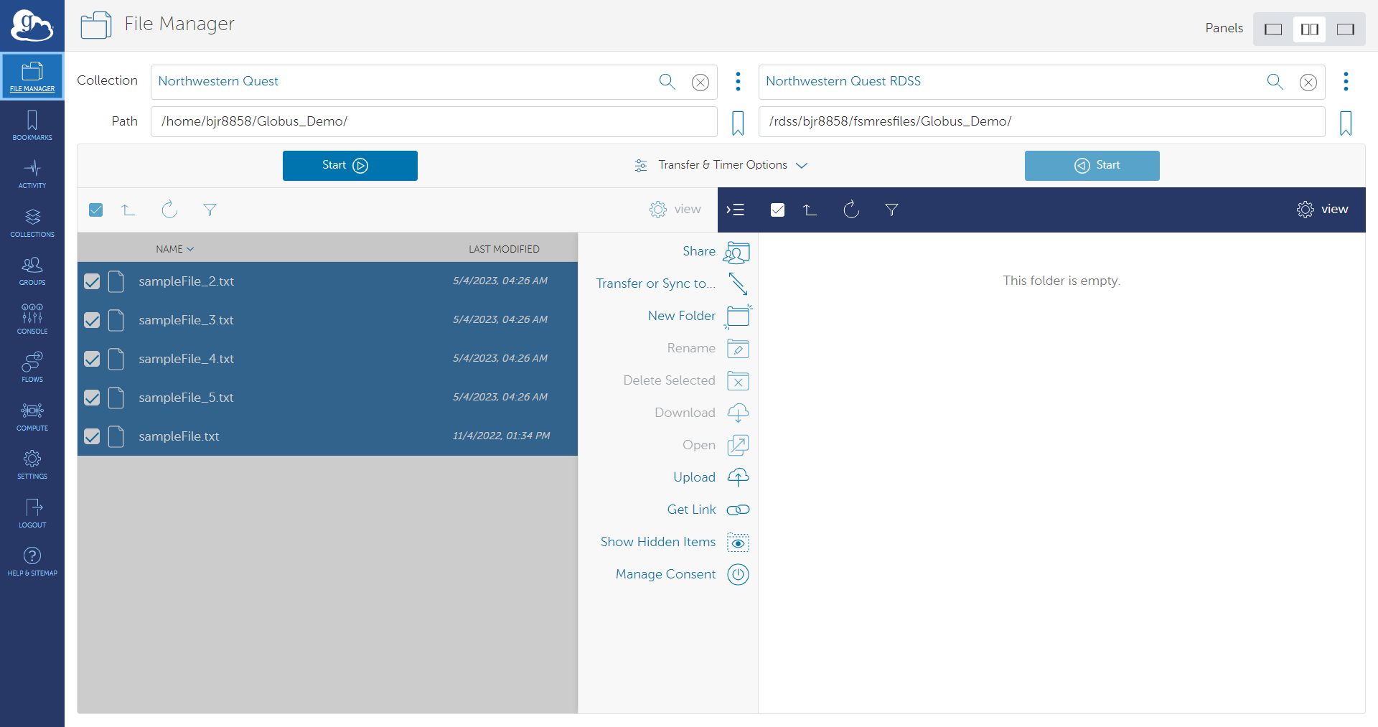
File Manager: Selecting Data Destination
When selecting the data destination you will need to select/enter a Collection name or UUID in the blank Collection field in the 2nd panel.
Once the you select a Collection, you can navigate to the path they want to access manually or type it into the Path field.
Globus will display any files and subdirectories that already exist in the path provided.

Slide 10
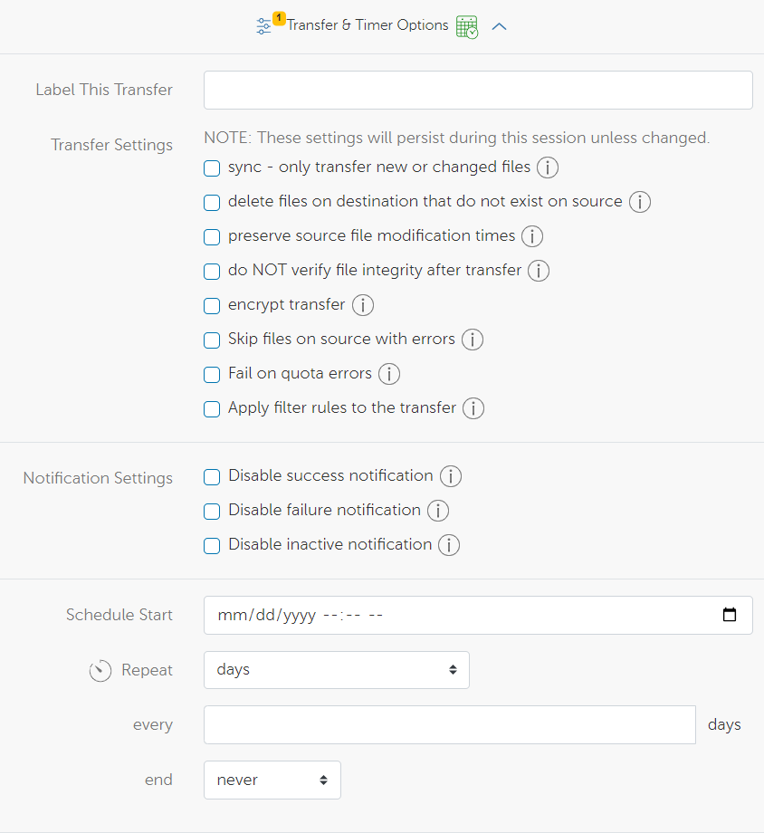
File Manager: Transfer & Timer Options

Slide 11
Recommended Transfer Options
Sync: Data in your files will only be transferred if it meets a selected criteria when comparing the source to the destination of the transfer. Criteria include:
  Modification time is newer
  File size is different
  File does not exist on destination
  File checksum is different
Preserve Source file modification times
Encrypt Transfer: Data in your files will be encrypted while in transit. Both endpoints must support encryption to ensure a successful transfer.
Skip files on source with errors: Files on source with "file not found" and "permission denied" errors will be skipped rather than causing the entire transfer procedure to fail.

Slide 12
Automating and Scheduling Globus Transfers
To setup a scheduled or recurring transfer, you would start by following the same steps as a manual transfer by selecting a data source and destination. Next select the transfer settings.
To automate/schedule you would need to complete the additional Timer Options:
Schedule Start: The date and time you want to schedule the automated transfer
Repeat: Define the unit of measurement for how often you want the scheduled transfer to repeat. Options are days, hours, and minutes
Every: Provide a numerical value to define the interval between recurring transfers based on the chosen unit of measurement
End: Define the end date that the recurring transfers should stop
Scheduled and repeating transfer tasks can be viewed in the Timers tab of the Activity page.

Slide 13
Key Steps in Using Globus CLI and Globus SDK
Authentication
Token handling
Define Transfer Task
  Source
  Destination
  Options
Submit Transfer

Slide 14
Authentication
Authentication is the process of verifying the identity of a user or system. It ensures that the entity accessing a system is who they claim to be. This process protects sensitive data and resources from unauthorized access.
Password-Based Authentication: Users provide a username and password to log in.
Token-Based Authentication: Uses tokens for identity verification.

Slide 15
What is a token?
Token:
  A token is a string of characters that serves as a means of authentication and authorization.
  Tokens are used to grant access to resources and perform actions within a system.
  They eliminate the need to repeatedly provide credentials.

Slide 16
What is an Auth Token?
Auth Token:
  An Auth Token, or Authentication Token, is used to verify the identity of a user.
  It is issued after successful authentication (e.g., logging in with a username and password).
  The Auth Token grants the holder permission to access Globus services and APIs.
  It contains user identity information and is used to obtain additional tokens for specific services

Slide 17
What is a Refresh Token?
Refresh Token:
  A Refresh Token is a special token used to obtain new access tokens without requiring the user to re-authenticate.
  It is a long-lived token that can be used to refresh an expired access token.
  Issued alongside the access token during initial authentication.
  When an access token expires, the refresh token is sent to the authorization server to obtain a new access token.

Slide 18
Define Source/Destination Collections
Name | UUID
Northwestern Quest | d5990400-6d04-11e5-ba46-22000b92c6ec
Northwestern Quest RDSS | 8f796c9e-f5c8-11e5-9842-22000b9da45e
Northwestern AWS us-east-1 N. Virginia | bf0474ea-df2f-45f6-82e3-41d062d84ce7
Northwestern AWS us-east-2 Ohio | a14148f0-23dc-488f-affd-bd981f919b10
Northwestern AWS us-west-2 Oregon | 880cd765-5d14-43f6-97a6-2dbb355f3560
Northwestern OneDrive Pilot | 930c2fcb-416e-4540-a757-496f86acbe70
*It is recommended that you leverage Guest Collections for automation scripts

Slide 19
What are Optional Elements?
Additional parameters that can be specified to customize and control the behavior of Globus transfer tasks. They provide flexibility and additional functionality for managing file transfers.

Slide 20
Command Options
-h, --help:
  Displays help information for the Globus transfer command.
-r, --recursive:
  Transfers directories recursively, including all subdirectories and files.
-F, --force:
  Overwrites existing files at the destination with no confirmation prompt. (Use with caution!)
-L, --no-overwrite:
  Skips transferring files that already exist at the destination.

Slide 21
Task Configuration
--label <label>:
  Assigns a descriptive label to the transfer task for easier identification and tracking.
--sync-level <level>:
  Defines the synchronization level, controlling how the transfer handles existing files (e.g., update, delete, etc.).
--verify-checksum:
  Verifies that the contents of the file were not corrupted in transit by doing a checksum comparison.
--notification <email>:
  Sends email notifications about the transfer status (success, failure, etc.) to the specified address.

Slide 22
Task Configuration
--encrypt:
  Encrypts the transfer in transit.
--preserve-mtime:
  Preserves source file modification time.
--skip-source-errors:
  Skips files on the source that generate errors.

Slide 23
Globus CLI
The Globus CLI is a powerful tool that allows users to interact with Globus services directly from the command line, facilitating scriptable transfers and task management.
Cross-Platform Compatibility. Available for Windows, macOS, or Linux
Allows increased control and flexibility of all aspects of your transfers

Slide 24
Globus CLI Live Demo Prerequisites
Prerequisites:
  Install Globus CLI to Quest
  Define source and destination collection variables based on UUIDs
  Provide endpoint consent to use the CLI

Slide 25
Install Globus CLI to Quest
module load python-anaconda3/2019.10
conda create --no-default-packages --name globus pip
source activate globus
pip install globus-cli

Slide 26
Authentication and Consent with Globus CLI
Authentication is the first step in using the Globus CLI.
Execute globus login to authenticate via your default web browser.
This process will grant you an Auth Token and a Transfer Token, which are necessary for accessing Globus services.
These tokens are stored locally and used by the CLI to authenticate your commands.

Slide 27
Define Source/Destination Collections
Name | UUID
Northwestern Quest | d5990400-6d04-11e5-ba46-22000b92c6ec
Northwestern Quest RDSS | 8f796c9e-f5c8-11e5-9842-22000b9da45e
Northwestern AWS us-east-1 N. Virginia | bf0474ea-df2f-45f6-82e3-41d062d84ce7
Northwestern AWS us-east-2 Ohio | a14148f0-23dc-488f-affd-bd981f919b10
Northwestern AWS us-west-2 Oregon | 880cd765-5d14-43f6-97a6-2dbb355f3560
Northwestern OneDrive Pilot | 930c2fcb-416e-4540-a757-496f86acbe70
*It is recommended that you leverage Guest Collections for automation scripts

Slide 28
Provide endpoint consent to use the CLI
After you authenticate with globus, you must provide consent to use the endpoints that you will access via the Globus CLI
globus session consent 'urn:globus:auth:scope:transfer.api.globus.org:all[*https://auth.globus.org/scopes/d5990400-6d04-11e5-ba46-22000b92c6ec/data_access]'

Slide 29
Build a Transfer Task (CLI)
The globus transfer command is the foundation for initiating a data transfer.
globus transfer [OPTIONS] SOURCE_ENDPOINT_ID[:SOURCE_PATH] DEST_ENDPOINT_ID[:DEST_PATH]
Required Elements:
  SOURCE and DESTINATION endpoints identified by their UUID
  File and directory PATHS. These paths are relative to the selected endpoints
Optional Elements:
  Globus transfer OPTIONS as CLI parameters
Reference:
  https://docs.globus.org/cli/reference/transfer/

Slide 30
Checking Task Status/Results (CLI) Live Demo
High level task status
  globus task show <taskID>
Successful transfers
  globus task show <taskID> -t
Skipped files
  globus task show <taskID> --skipped-errors
Event list
  globus task event-list <taskID>
  globus task event-list --filter-errors <taskID>
Cancel Task
  globus task cancel <TASK-ID>
List
  globus ls <UUID>:/Path/to/your/directory
Reference:
  https://docs.globus.org/cli/reference/task_show/
  https://docs.globus.org/cli/reference/task_event-list/

Slide 31
Bash Script
#!/bin/bash
#SBATCH -A a9009 # Allocation
#SBATCH -p short # Queue
#SBATCH -t 00:40:00 # Walltime/duration of the job
#SBATCH -N 1 # Number of Nodes
#SBATCH --mem=1G # Memory per node in GB needed for a job. Also see --mem-per-cpu
#SBATCH --ntasks-per-node=1 # Number of Cores (Processors)
#SBATCH --mail-user=brian.roland@northwestern.edu
module load python-anaconda3/2019.10
source activate globus
source_ep=0d2961d1-cb8a-4c10-afe9-1d1edb1ff9c2 ##Quest Bootcamp Demo
dest_ep=b306501e-284a-4013-8b8e-0769877d9823 #RCDS Bootcamp Demo
globus transfer -r $source_ep:~/myFiles/ $dest_ep:~/

Slide 32
What is the Globus SDK?
SDK stands for Software Development Kit. The Globus SDK provides a set of Python tools that allow you to:
Automate Transfers: Instead of clicking through websites, write scripts to transfer files exactly when you need them, scheduled or on-demand.
Integrate with your Applications: Embed Globus transfer capabilities directly within your own research tools and workflows.

Slide 33
Why use the Globus SDK?
Custom Control: Go beyond the standard Globus web interface for tailored processes.
Efficiency: Automate tasks that would be tedious to do manually, especially for many files.
Power: Tap into the full potential of Globus for features like resuming failed transfers, monitoring progress, and more.

Slide 34
Globus SDK Live Demo
Prerequisites
Register your applications via Globus Developer Console found in Globus Settings
  Thick Client (Native App)
  Script Client (Service Account App)
Add application as user on Globus Guest Collections as needed

Slide 35
Registering application with Globus
Any applications or scripts that will leverage the Globus SDK need to first be registered with Globus via the Globus Developer Portal.
The process of registering your application with Globus is a two-phase process:
  Define a Globus Project
  Register the application under a Globus Project

Slide 36
Globus Project
A Globus Project is a way to Organize and manage related applications, endpoints, and other resources.
You can group multiple applications under a single umbrella for easier management

Slide 37
Create Project
Access the Developer Portal:
  Log in to the Globus Developer Portal
Create a New Project:
  Navigate to "Projects".
  Click on "Create a Project".
  Provide the required details such as Project Name and Contact Email.
  Submit the form to create the project.

Slide 38
Register an App
After creating the Globus Project to house your application(s), you will next need to start the process of registering your application.
Globus will provide a list of application types that you can chose to register with along with a description of the application type.
Most research use cases will leverage:
  Service account or application credential for automation (Service Account App)
  Thick client or script that will be installed and run by users on their devices (Native App)

Slide 39
Native App
An application that operates with user interaction
Uses OAuth2 for user authentication and authorization.
An application installed on a user's device (e.g., desktop, mobile).
Acts on behalf of the authenticated user
Client ID used as part of authentication process
Use NativeAppAuthClient to start the OAuth2 flow.
Redirects the user to the Globus login page for authentication and authorization code.

Slide 40
Service Account App
An application that operates without user interaction.
Typically used for backend services or automated tasks.
Client ID and Client Secret used for authentication
Does NOT act on behalf of other users.
  Globus Guest Collections required to provide app access to Collection data
Use ConfidentialAppAuthClient to authenticate with the Globus Auth service.
Request an access token using the client credentials flow.

Slide 41
Register App
Select the Project:
  In the Globus Developer Portal, select the project under which you want to register the application.
Navigate to Applications:
  Click on the "Apps" tab within the project.
Register a New Application:
  Click on “Add an App".
  Select App type and fill in the required details, including:
    Application Name
    Redirect URIs (https://auth.globus.org/v2/web/auth-code)
Submit the form to register the application.
Configure Application Settings:
  After registration, configure additional settings such as OAuth2 settings, generate Client Secret, and more.

Slide 42
Globus SDK Live Demo
Authentication
Token Management
Build Transfer Task
Submit Transfer
Check Results

Slide 43
References
Globus Doc
Globus CLI
Globus SDK
Globus github

Slide 44
Questions? globus-help@northwestern.edu

